Slide 1
MITM Attack on an OPC-UA ICS System
CYSE 470-002: Human Factors In Cyber Security
Professor Roozbeh Haghnazar
By: Seham Ahmed, James Cogswell, Mitch Martinez, Robert Weiner

Slide 2
What is a man-in-the-middle (MITM) attack?
MITM is a network attack requiring at least three people (hosts). Let’s name these people Alice and Bob (who intend to communicate), and Eve who is the man-in-the-middle.
Alice sends Bob information over the network. Eve, being the evil one here, has several choices she can make. Here are a few:
Eve can block the transmission from Alice to Bob and impersonate the intended recipient to steal information.
If the information is in plain text, Eve can sniff the packet and take the information without Alice knowing.
Eve can alter the information and forward it to Bob without him knowing anything changed.
Neither Alice or Bob have any idea that Eve is sniffing, altering, or blocking their communications.

Slide 3
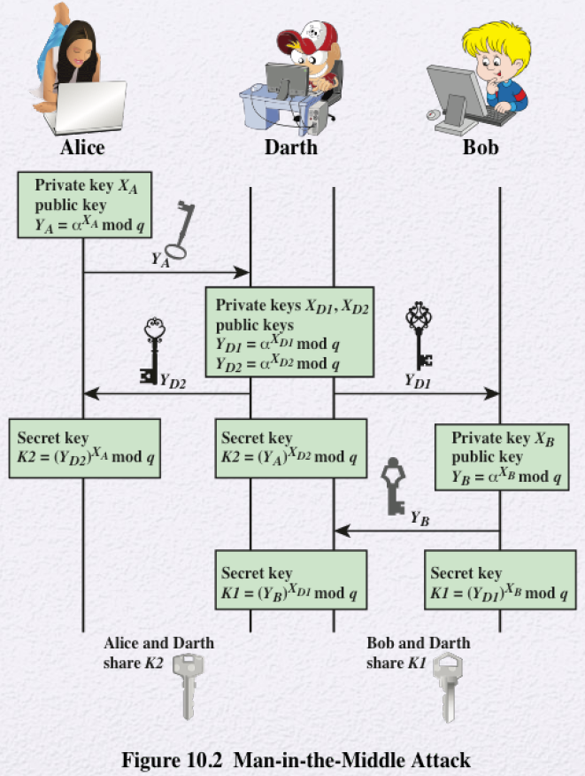
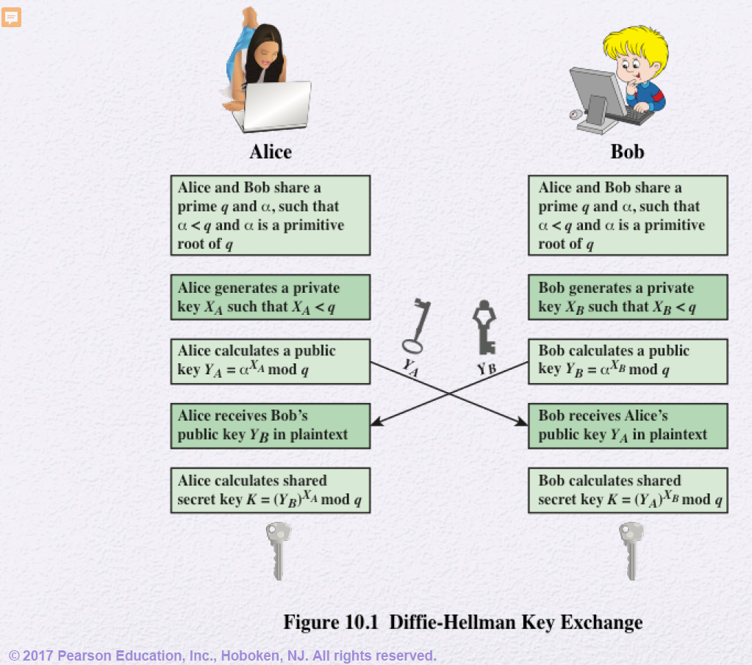
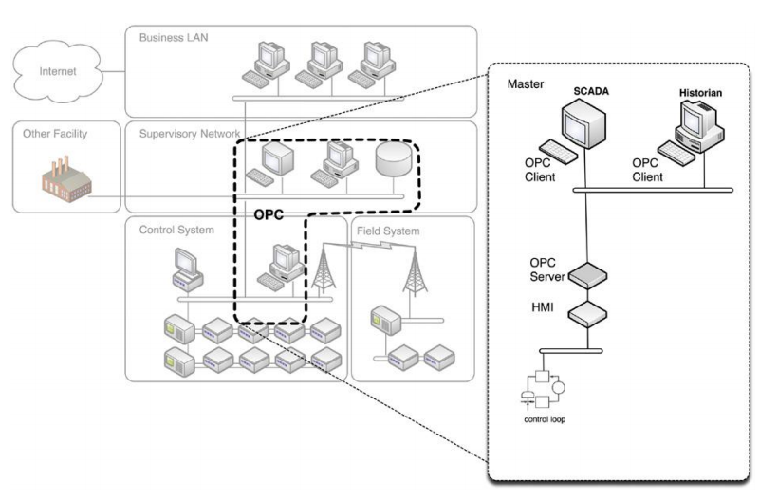
Literature Review

Slide 4

7 Types of MITM Attacks
IP Spoofing - Eve can impersonate Alice or Bob by using their IP address when communicating
DNS Spoofing - Forcing a user to a fake website rather than the real one they intend to visit
HTTPS Spoofing - An attacker can make your browser believe a malicious website is secure
SSL Hijacking - Devices connecting to HTTP servers can often be auto-redirected to secure versions of the server (HTTPS). Hijacking this connection requires the attacker to use a server and a computer to intercept the data during transmission
Email Hijacking - Attackers can target email accounts of institutions such as banks. They spoof the bank’s email address and send instructions to customers, which they will often trust and follow those instructions. The victim then ends up sending money to the attacker.
Wi-Fi Eavesdropping - Attackers can set up public Wi-Fi connections that look legitimate to the untrained eye. Attacker can monitor user activity and intercept information such as login credentials, credit card info, etc.
Stealing Browser Cookies - Stealing browser cookies can allow the attacker to gain access to your passwords, address, or other PII

Slide 5
How Man-In-The-Middle (MITM) attacks work
A connection request is sent from Alice to Bob
Eve intercepts this request and responds to it pretending to be Bob
Eve also sends a connection request to Bob pretending to be Alice
Eve now has two connections: One between herself and Bob, and one between herself and Alice
In both connections, Alice or Bob think Eve is the other person
At this point, Eve has full access to reading all communications, and even modifying them before passing the messages on

Slide 6
What is the Diffie-Hellman (DH) key exchange
When Alice and Bob want to communicate for the first time over an unsecured network using a symmetric encryption algorithm, they need a way to share the secret key with each other
Alice encrypts the secret key using Bob’s public key and her own private key (Bob does the same using his private key and Alice’s public key)
Alice and Bob share these secret keys with each other and they will be identical
The shared secrets are then used as the encryption key for symmetric encryption algorithms

Slide 7
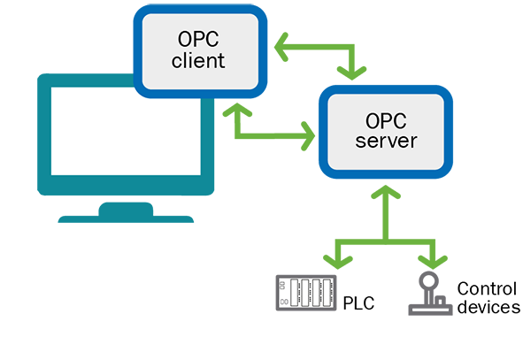
OPC-UA Server-Client Model
Open Platform Communication - Unified Architecture
Collective suite of Windows-based Object Linking and Embedding (OLE) protocols implemented for process control systems
Interconnects distributed control systems (DCS) typically via Ethernet TCP/IP, HTTP, …
Data transfer to historians, data collection within human machine interfaces (HMI) and other supervisory controls
OPC-UA has overhead due to SOAP over HTTP encryption services
OPC is rooted in the Windows operating system (OS)
Client calls a local process which is the performed on the server
SCADA protocol

Slide 8
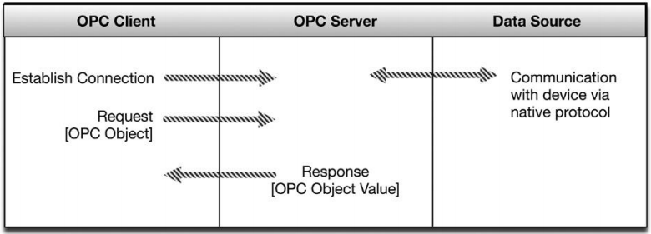
OPC-UA Security Concerns
weak authentication, and passwords are often weak when authentication is enforced, legacy authentication services
Inadequate or nonexistent logging exacerbates this by providing insufficient forensic
IEC 61158, fieldbus
Defense in depth IDS/IPS firewall, removal of extra ports,

Slide 9
MITM on DH Key Exchange
Alice calculates her public key using her private key along with the base g and prime p that she and Bob had agreed upon and attempts to send it to Bob
Eve intercepts the message and applies her own secret key using the same g and p values
Eve impersonates Alice and sends her (Eve’s) public key to Bob. Bob thinks that this is Alice’s public key.
Eve impersonates Bob and completes the DH key exchange with Alice.
Bob responds and sends his public key to Alice. Eve intercepts it, impersonates Alice and completes the DH key exchange with Bob.
Eve now has calculated secret keys with both Bob and Alice. Eve will intercept all messages, decrypt them with the secret key associated with the sender, store a copy of (or alter) the message, encrypt the message again with the secret key associated with the intended recipient, and send it.
Alice and Bob think they’re having legitimate communication. Meanwhile, Eve can access all of their messages from now on until Alice and Bob change symmetric keys.

Slide 10
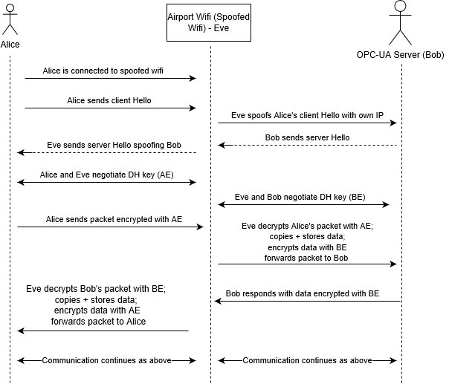
UML Diagram

Slide 11
MITM prevention
Implement Authentication Certificates - certificates would authenticate machines that operate within the network as valid operators
HTTPS instead of HTTP - HTTPS is more secure as it provides data encryption and requires for SSL certificate
Only sign into secure systems from secure networks (E.G. Don’t remote access a SCADA system from public WiFi)
VPN - VPN is secure for exchanging data as all traffic is authenticated and only authorized users are able to see the decrypted data
Monitor web traffic- abnormal activity could be flagged and potential threats could be blocked
WEP/WPA encryption - all data would be encrypted and if intercepted it will be unreadable

Slide 12
Alternative approach
Timing attack
Exploit that would allow an attacker to find vulnerabilities by studying how long the system takes for different inputs
Variables include RAM/cache hits, performance optimization, branching/conditional statements, processor instructions.
While timing of a cryptographic devices are not constant, the attack would lead to a leakage of information about secret parameters involved.
The attacker would use timing measurements and analysis to recover the secret for the system.
After gaining the secret key, the attacker would gain access to the system.

Slide 13
References
Mallik, Avijit, et al. “Man-in-the-Middle-Attack: Understanding in Simple Words.” International Journal of Data and Network Science, 2019, pp. 77–92., doi:10.5267/j.ijdns.2019.1.001.
Tilborg, Henk C. A. van, and Sushil Jajodia. Encyclopedia of Cryptography and Security. Springer, 2011

